Slide 1
Introduction to advanced analytics
Data Science Training Roadmap
January 2024
SESSION WILL BE RECORDED

Slide 2


Course Facilitators
Enjoys hiking, traveling, cooking, reading, and hanging out with my family
Avid sports fan
Accidentally used liquid sugar to clean my hands in a supplier meeting at Pinda.
10 years at Novelis
Mitchell Logan
Sr. Manager, Data Governance & Support
Enjoys videogames, running and spending time with family
College basketball and college football fan
Was formerly a college engineering professor
1 year at Novelis
Russ Krenek
Data Science and Insights Engineer

Slide 3
agenda
Introduction …………………………………………………………. 10 min
Course overview ………………………………………………....... 10 min
What is advanced analytics in Novelis Part 1 ……………………. 25 min
Break …………………………………………………………………. 10 min
What is advanced analytics in Novelis Part 2 ……………………. 20 min
Project discussion …………………………………………………….15 min
Q & A ……………………………………………………….…….….… 5 min
* Datacamp is used per self-learning / e-Courses platform: www.datacamp.com

Slide 4



Ground rules
Turn on your webcam!
Ask questions / comments in the chat feature of MS teams
Be prepared to interact and give feedback

Slide 5

Safety minute
The importance of proper rest
What happens at home can indirectly influence workplace hazards.
Employees who don’t get enough rest can fatigue more easily and make mistakes, putting themselves and their coworkers at risk of injury.
The Institute of Medicine of the National Academies reports that people struggling with sleep have a much higher risk for accidents.
Highly fatigued workers are 70% more likely to be involved in workplace accidents compared to workers with lower fatigue levels.
Sleep sharpens our cognitive ability, enabling us to think fast, act fast, and act smart.
Most adults need 7+ hours of sleep/day according to Sleep Foundation.
https://www.wawanesa.com/us/blog/12-parking-lot-safety-tips

Slide 6






Websites and digital tools being used

Slide 7
course overview

Slide 8




DATA SCIENCE PROGRAM objective
What?
The Digital Data Science team will kickoff new training sessions per capability building to potential Citizen Data Scientists candidates across different Novelis sites and function areas
Introduction
Pre-work
Virtual Classroom
Project completion
Introduction
Assigned exercises in Datacamp*
Theory and hands-on exercises
Project completion
Advanced Analytics introduction
Project Selection
* Datacamp is used per self-learning / e-Courses platform: www.datacamp.com

Slide 9
Data science Program timeline (updated)
When?
Below is the timeline specified for the DS Training program:
Jan
Feb
March
April
May
June
July
Kick-Off &
Introduction
Pre-work
E-Learning Datacamp
Pre-work
E-Learning & Foundationals in DS
Project
Assignment
Kick-Off
&
Introduction
Jan 23 - 25
Duration: 1.5 hours
Start date: Jan 29, 2024
End date: March 15, 2024
Duration: 7 Weeks
Investment: 18 - 26 hours
Start date: Mar 25, 2024
End date: May 10, 2024
Duration: 7 Weeks
Investment: 40 - 48 hours
Optional bonus homework: 26 – 30 hours
Start date: May 20, 2024
End date: July 16, 2024
Duration: 13 weeks
Investment: 60 - 80 hours

Slide 10

Prerequisite coursework
Intro to Data Science in Python
4 Hours
Intro to Data Visualization with Matplotlib
4 hours
Data Manipulation with pandas
4 Hours
Analyzing Police Activity with pandas
4 Hours
Data Science for Business
2 hours
Data Camp
DS participants will undertake the following pre-work
https://app.datacamp.com/learn/courses/data-science-for-business
https://app.datacamp.com/learn/courses/introduction-to-data-science-in-python
https://app.datacamp.com/learn/courses/introduction-to-data-visualization-with-matplotlib
https://app.datacamp.com/learn/courses/data-manipulation-with-pandas
https://app.datacamp.com/learn/courses/analyzing-police-activity-with-pandas
“These are the mandatory courses selected as pre-requisites, once finalized you can move forward to the next level:
Virtual Classroom Training!”
* Datacamp is used per self-learning / e-Courses: www.datacamp.com

Slide 11


Virtual classroom training
Please note that all pre-work needs to be completed (DataCamp will be checked!) to move onto next phase
A self-assessment survey will be sent out to all of the participants that have completed all the pre-work (e-learning courses)
The evaluation of this self-assessment will help us to get the final list of people to participate on the next phase: Virtual Classroom training sessions
Weekly office hours will be held (bring your questions to the team)
VCT Duration:
7 Weeks / Total investment of hours during this period of time are is ~ 40 - 48 hours; 26 – 30 hours additional if completing optional homework assignments

Slide 12
Introduction to advanced analytics
Introduction to Advanced Analytics

Slide 13
Project selection & completion

Slide 14
Project assignment
Requirements:
Participants need to select a project that applies data science techniques and modeling tools
Project will follow the digital advanced analytics methodology, DMAIC route
Project needs to be approved by direct supervisor and aligned with job
Project has to have some sort of business value
Assistance:
Digital COE team will support virtually and on-demand per required
Project will follow the gate review process as defined by the Data Science “DMAIC” process
Multiple students are allowed to work on a single project in certain instances (determined on a case by case basis)
Duration:
13 Weeks / Total investment of hours required per completion of project assignment is ~ 60- 80 hrs.

Slide 15
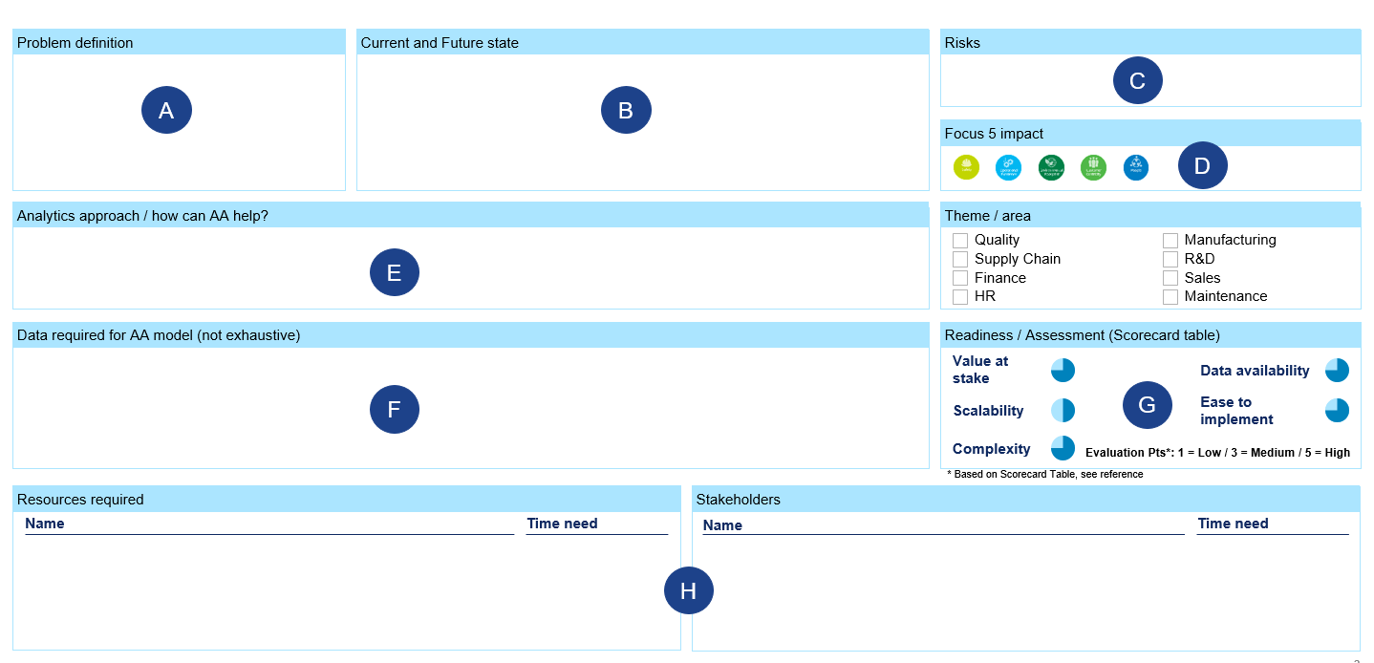
Project charter form
Step 1: Define Problem

Slide 16
Q & A

Slide 17
Appendix

Slide 18
Tools matrix
Prescriptive
Eagle Web
Predictive
MiniTab
Diagnostic
Power BI
Spyder / Jupyter Notebook
Excel
Data bricks
Descriptive
Self Service
Programming

